Slide 1
Project Presentation of CO-OP Project at Industry (Module-2) (22CS421)
On
Wheat Lodging Detection Using XAI and Deep Learning
Vanshita Garg (2210990949) Vivek Goyal (2210990968)
Medha Goel (2210991915) Saloni Sachdeva (2210992231)
Supervised By
Dr. Ashish Kumar, Assistant Professor, Chitkara University
Department of Computer Science and Engineering,
Chitkara University, Punjab

Slide 2
Agenda
Introduction
Impact of Lodging
Problem Statement
Objectives
Traditional Machine Learning Models
Deep Learning Architectures
Models Used
Training and Evaluation
Results
Conclusion & Future Scope
2

Slide 3
Introduction
Wheat is one of the most important staple crops globally and plays a crucial role in ensuring food security. However, its production is often affected by environmental factors such as wind, rainfall, and soil conditions.
One major issue is lodging, where crops bend or fall from their upright position. This affects crop growth, reduces productivity, and creates challenges in harvesting.
Lodging refers to the bending or flattening of wheat plants due to external forces or structural weakness.
Types:
Stem Lodging → bending of upper plant
Root Lodging → failure at root level
Main Causes:
Strong winds and heavy rainfall
Excess nitrogen fertilization
High plant density
3

Slide 4
Impact of Lodging
Lodging has a significant negative impact on agriculture:
Reduces crop yield by 30–50% due to poor grain filling and reduced photosynthesis
Degrades grain quality (shriveling, low weight, poor market value)
Increases risk of fungal diseases due to excess moisture and low airflow
Makes harvesting difficult, causing higher grain loss and labor cost
Leads to significant economic losses for farmers
Disrupts nutrient and water uptake in plants
Causes uneven crop maturity and non-uniform harvest
Increases chances of crop damage due to soil contact (rotting, contamination)
4

Slide 5
Problem Statement
Traditional lodging detection methods rely on manual field inspection.
Limitations:
Time-consuming and labor-intensive, especially for large agricultural fields
Prone to human error, leading to subjective and inconsistent results
Inefficient for real-time monitoring and early detection
Not scalable for large-scale farming and precision agriculture
Delays in detection can lead to increased crop damage and losses
Need for Solution: There is a strong need for an automated, accurate, and scalable system that can detect lodging efficiently, enable early intervention, and support modern precision agriculture practices.
5

Slide 6
Objectives
The objectives of this project are:
To detect wheat lodging using UAV-based RGB images
To compare machine learning and deep learning models
To improve accuracy of detection
To develop a scalable and efficient solution
To incorporate Explainable AI (XAI) for transparency

Slide 7
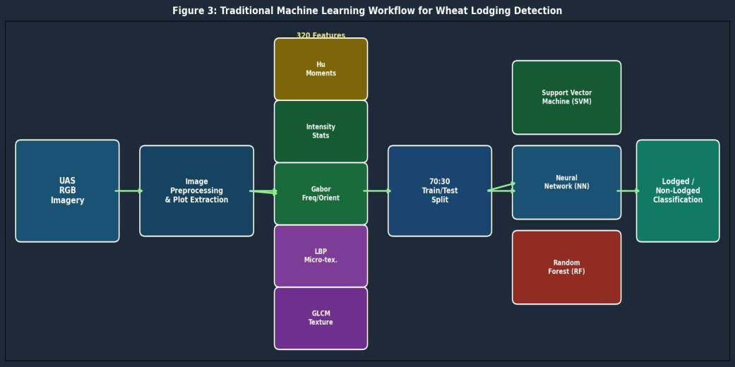
Traditional Machine Learning Models
Training Setup
70:30 train-test split | 10 runs per model | Tukey's test (p=0.05)
Random Forest (RF)
Multiple decision trees via bootstrapped subsets + majority voting
Best reliability — lowest standard deviation across all experiments
Support Vector Machine (SVM)
Optimal hyperplane separating lodged/non-lodged classes
RBF kernel for non-linear pattern classification
Neural Network (NN)
Interconnected layers learn non-linear feature relationships
More sensitive to parameter selection than RF
7

Slide 8
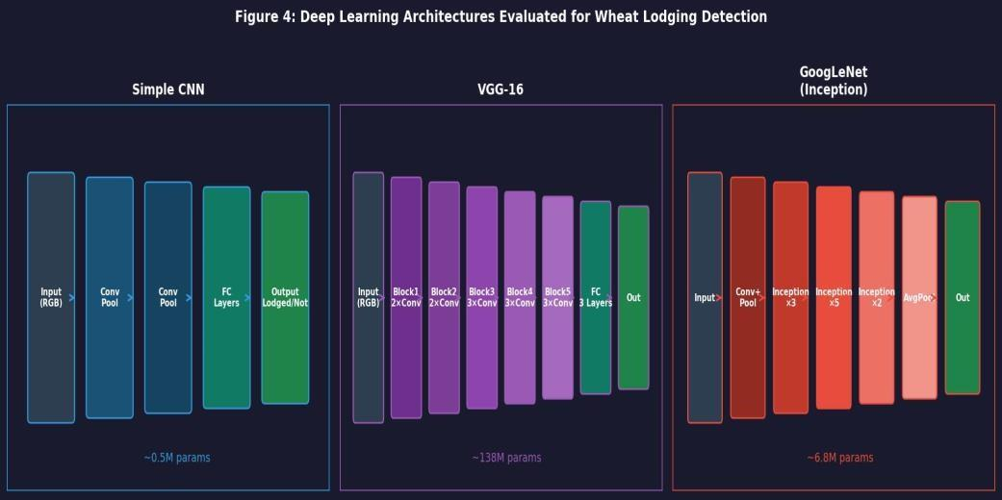
Deep Learning Architectures
All CNNs implemented in MATLAB | Augmented: rotation, flipping, scaling
Simple CNN (Baseline ~0.5M params)
Lightweight architecture — establishes baseline deep learning benchmark
VGG-16 (~138M params)
16-layer deep sequential network with strong feature learning
Highest computational cost among the three models
GoogLeNet — Best Model (~6M params)
Inception modules apply multiple filter sizes simultaneously
Multi-scale feature extraction — ideal for varying lodging patterns
Most computationally efficient with highest accuracy
8

Slide 9
Models Used
Machine Learning Models:
Random Forest
Support Vector Machine
Neural Network
Deep Learning Models:
CNN
VGG-16
GoogLeNet
Deep learning models automatically learn features from images.

Slide 10
Training and Evaluation
Data split: 70% training, 30% testing
Data augmentation applied
Evaluation Metrics:
Precision
Recall
F1-score
Accuracy
Multiple runs performed for reliable results.

Slide 11
Results
Random Forest outperformed other traditional machine learning models
Deep learning models achieved significantly higher accuracy than ML approaches
GoogLeNet delivered the best performance with ~94% accuracy
Model accuracy improved when trained on later-stage crop images
Deep models captured complex spatial patterns more effectively
Results demonstrate the effectiveness of AI-based automated lodging detection systems
11

Slide 12
Conclusion & Future Scope
Key Findings
UAS RGB imagery with ML provides scalable, affordable lodging detection
Random Forest: most reliable traditional ML with lowest variance
GoogLeNet: highest accuracy (94.1%) via multi-scale Inception design
No statistically significant difference between RF and GoogLeNet
Later imagery (Aug 8) consistently outperforms early-stage (Jul 23)
Implications
Low-cost RGB drones can replace expensive multispectral sensors
Deep learning better suited for large-scale agricultural monitoring
Future Scope
Regression models to estimate lodging severity (beyond binary classification)
Integrate XAI for interpretable decisions | Real-time drone operations
Explore Vision Transformers (ViTs) and edge-computing deployment
12

Slide 13
Thank You
13

